Slide 1
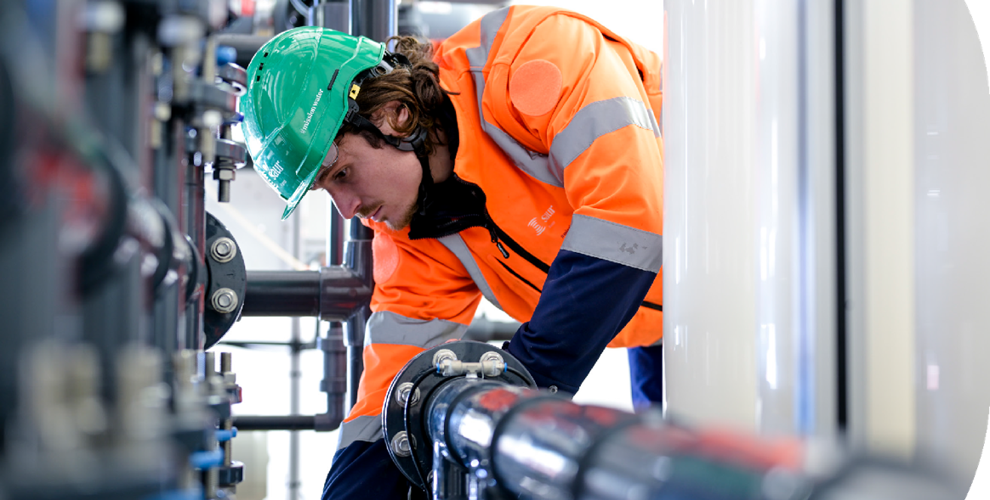
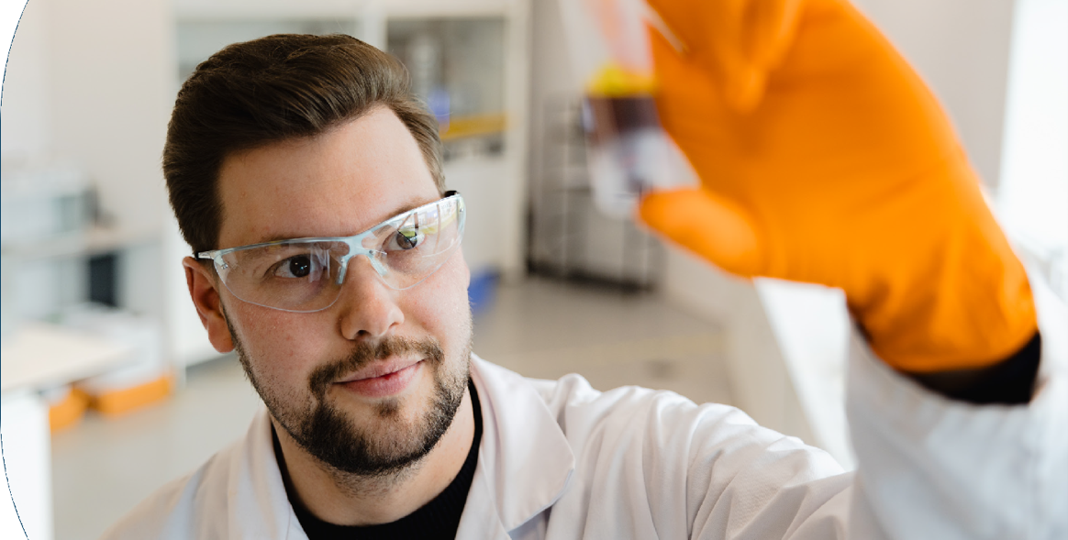
Sustainability Roadmap
March 2025
#mission water

Slide 2

Water :
a bigger challenge
than ever
From tap water...
... to the ocean
2021-2025
Core mission: managing tap water and wastewater.
Our role focused on the small water cycle-capturing, treating, distributing, and purifying water
2025-2030
Today, we have a greater responsibility: protecting the entire water cycle.
Rivers, groundwater, and oceans are all interconnected. If we want to ensure both quality and quantity of water for the future, we must rethink our approach to be able to help our clients to adapt to climate change.
It is no longer enough to tackle climate shocks
(drought, storms, tornado…) and increasing pollutions
2
Saur_Sustainability Roadmap

Slide 3




In this perspective we have reshaped our Sustainability
roadmap 2025-2030, that lies at the core of theGroup's Strategy 2030 to support our ambition to be the champion of the hydric transition.
#missionwater
#missionwater2030
1
2
3
Putting our employees and clients at the heart of change
OUR FOUNDATION : Our expertise is our strength. By sharing it with our customers and partners, we create positive impact far beyond our infrastructures
Acknowledging that our resources are limited but circular
OUR SOLUTIONS : we recognize that resources have limits and that we must take into consideration the planet boundaries. By combining nature-based solutions, innovative technologies and mobilizing circular economy we will help avoid ecological tipping points.
Adopting a shared and ethical governance
OUR RESPONSIBILITY : we do not act alone. we engage with stakeholders and ensure transparency in our commitments.
3
Saur_Sustainability Roadmap

Slide 4



FOUNDATION
SOLUTIONS
RESPONSIBILITY
Putting our employees and clients at the heart of change
Acknowledging that our resources are limited but circular
Shared & ethical governance
Priority to employees health & safety
Accident frequency (TF1)
Accident frequency (TF2)
Accident frequency (severity rate)
Address health issue through
a communication campaign and associated actions
Better managing our most vital resource: water Reduce our water consumption and that of our clients
Number of REUSE projects sold (municipal, industrial, buildings) compared to 2024
Municipal network performance
Protect water resources against the impact of climate change
Sites assessed with their vulnerability to droughts and storms
Sites assessed with their impact on biodiversity
Cutting CO2 emissions…
Carbon trajectory under revision (will be presented before the end of Q4 2025)
Top 20 suppliers of the most emissive categories challenged on their climate transition plan and alternatives products (scope 3)
… supported by a circular approach
Top 5 of our products/ solution assessed through a LCA
Percentage Increase for recovery
of nutrients as part of new projects sold compared to 2024
Sharing the value with our stakeholders
% of managers concerned by a variable remuneration based on an ESG criteria
A shared and strong ESG governance
Frequency of consultation of our main stakeholders on ESG
Strategic projects assessed through a Sustainability evaluation
Continuing to set up exemplarity in our practices
% of signatures of the ethics and compliance declaration
% of employees trained about respect for human rights
Considering the most vulnerable end-users and population
% of Saur Solidarities projects promoting access to water
7,8 %
13,2 %
0,4 %
100 %
+ 20 %
82 %
At least 1/year
4/year
100 %
100 %
100 %
60 %
And creating the condition for employees empowerment and engagement in Sustainability initiatives
Employees involved in sustainability-linked actions
100 %
100 %
100 %
100 %
+ 20 %
25 %
A company where the diversity of profiles is a strength
% of women in executive position
Meeting of the local steering committee on disability issues
41 %
2/year
Building lasting partnerships with our clients and end-users
Group Customer centricity Auto Assessement (sales, support & operationnal staff) through Client fresko
100 %
4
Saur_Sustainability Roadmap

Slide 5
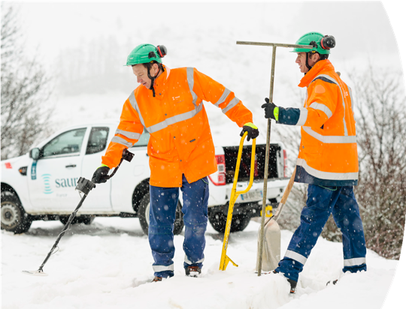
Putting our employees and clients at the heart of change
1
Putting our employees at the heart of Saur's transformation means guaranteeing a healthy, safe and stimulating working environment, where each employee feels valued
and protected. Security of our employees in our main preoccupation.
In the future, Saur wants to develop new initiatives to prevent employee health problems and promote physical and mental well-being. Taking care of our employees is the starting point for developing a culture of commitment and recognition, where employees become the first ambassadors and players in the company's CSR approach because the company have empowered them. Moreover the diversity of our employees
is a key asset we want to preserve and develop.
Priority to employee health, in particular safety and well-being…
Priority to employees health & safety
Accident frequency (TF1)
Accident frequency (TF2)
Accident frequency (severity rate)
2030 Target
7,8 %
13,2 %
0,4 %
Address health issue each year through a communication campaign and associated actions
At least one per year
And creating the conditions for employees empowerment and engagement in Sustainability Initiatives
2030 Target
% of employees engaged in a Sustainability action/initiative 25 %
A company where the diversity of profiles is considerd as a strengh
2030 Target
41 %
2 per year
% of women in executive position
Meeting of the local steering committee on disability issues

Slide 6
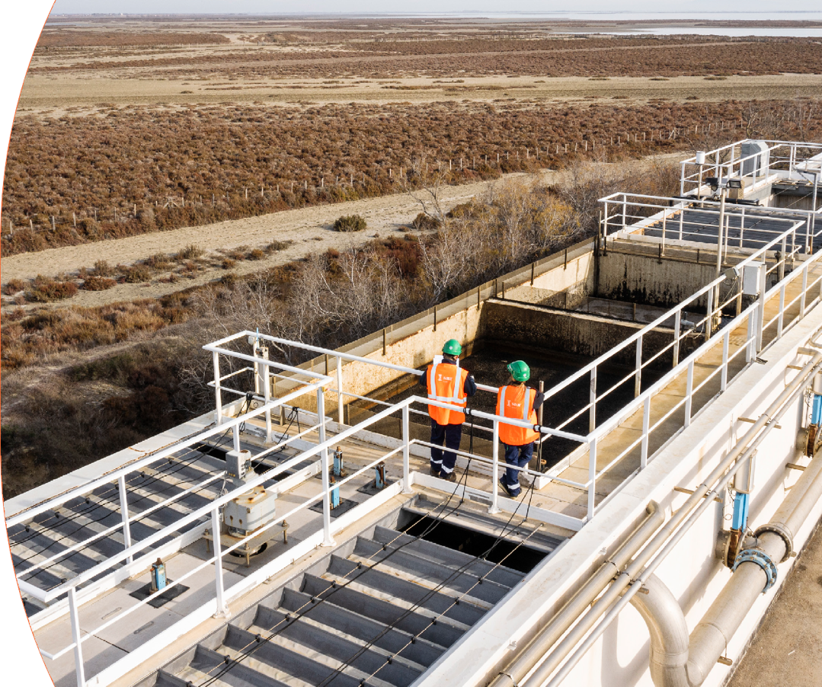
Putting our employees and clients at the heart of change
1
It is by intensifying our territorial roots, developing local partnerships and privileged opportunities for dialogue with local authorities and, through them, with end users, and by proving in design and adaptive solutions to our industrial clients that we will co-construct the solutions of tomorrow and define the new economic models of water.
Through a Serious Game (in the format of a card game and in a digital version),
Saur aims to develop our employees' customer-centricity and awareness of the impact we all have in our missions on customer satisfaction,
so that we can give our very best in this area.
Building lasting partnerships with our clients and end users
Customer centricity Auto Assessement
(sales, support & operational staff) through the Client fresko
2030 Target
100 %

Slide 7

Acknowledging that our resources are finite but circular
2
Optimizing our water footprint for sustainable resilience
of territories and industries to meet the challenge of increasing scarcity of water resources and adapt to climate change consequences to be able to protect our activity and guarantee the continuity of service.
Combating climate change by reducing our CO2 emissions, taking into account the specific characteristics of the water sector and relying the dynamics of the territory in which our municipal customers are involved and the circular economy.
Reduce our water consumption and that of our clients
Cutting CO2 emissions…
2030 Target
+ 20 %
82 %
2030 Target
Number of projects of REUSE sold compared to 2024
Network performance (municipal)
Actual Carbon trajectory is under revision
Top 20 suppliers of the most emissive categories challenged
on their climate transition plan and alternatives products (scope 3)
100 %
Protect water resources against the impact of climate change
… supported by a circular approach
2030 Target
% of sites assessed regarding their exposition and vulnerability to drought and storms
% of sites assessed regarding their sensitivity to biodiversity
2030 Target
100 %
100 %
100 %
Top 5 of our products/ solution assessed through a LCA
Percentage Increase for recovery of nutrients as part of new projects sold compared to 2024
+ 20 %

Slide 8
Adopting a shared and ethical governance
3
Shared, responsible and invigorating governance strengthens the cohesion
and sustainable performance of our company. Sharing the value created equitably with our employees and including CSR criteria in their variable remuneration creates a collective dynamic within the company to take action in line with our sustainable development ambitions. This direct link between CSR performance and financial
recognition motivates and empowers everyone to contribute actively to our objectives. Engaging our main stakeholders is our CSR journey is also very important as CSR determine the strategic orientations of the group. In addition, at Saur, CSR drives
and the business and modulated the business. It means that every R&D project, every M&A project and every important project submitted to an engagement.
Promoting a culture of integrity and transparency
and being vigilant about human rights abuses throughout our value chain are fundamental to maintaining the trust of our stakeholders. This also enables us to consolidate
our reputation and ensure that our activities are conducted in an exemplary manner. Saur also wants to give a place
to solidarity and through its foundation, support the access to water.
Continuing to set up exemplarity in our practices
2030 Target
Sharing value with our stakeholders
2030 Target
% of signatures of the ethics and compliance declaration
% of our employees have been trained through an e-learning about human rights
100 %
% of managers concerned by a variable remuneration based on an ESG crieteria
100 %
100%
A shared and strong governance for implementation of CSR from the starting point of every projects
Considering the most vulnerable end-users and populations
% of Saur Solidarités projects promoting access to water
2030 Target
60 %
2030 Target
Frequency of consultation of our main stakeholders on ESG (shareholders, NGOs, agricultures, end-users)
/ Aquaverse 2.0 dialogues
M&A projects, R&D projects and projects submitted to a CEG assessed through a CSR evaluation
4 events / year
100 %

Slide 9








Next steps
Q 1 2025
Q 2 2025 Q 2,3,4 2025
Validation by
decision-making bodies
+ implementation of the governance
External & internal communication Preparation
of the Roadmap implementation in each entities
Internal sensibilization Adaptation per BU
(France, international, industry)
Aligned with Strategy 2030 deployment
This CSR roadmap will permit to introduce with a more strategic point of view the CSRD

Slide 10

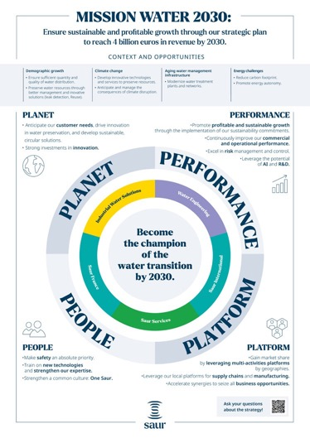

More info on our CSRD policy? Check out the following media!
Our 2025 CSR report
A 60-page documented report filled with examples and indicators to understand our CSR trajectory and track our performance.
Available in: French, Spanish, English
Our CSR Posters
Every three months, a new poster is displayed in your entity to highlight a concrete CSR action implemented within our Group.
Available in: French, Spanish, English
The Saur Solidarity Endowment Fund Report
Discover the 10 projects led by employees and supported by our endowment fund.
Available in: French, English

Slide 11

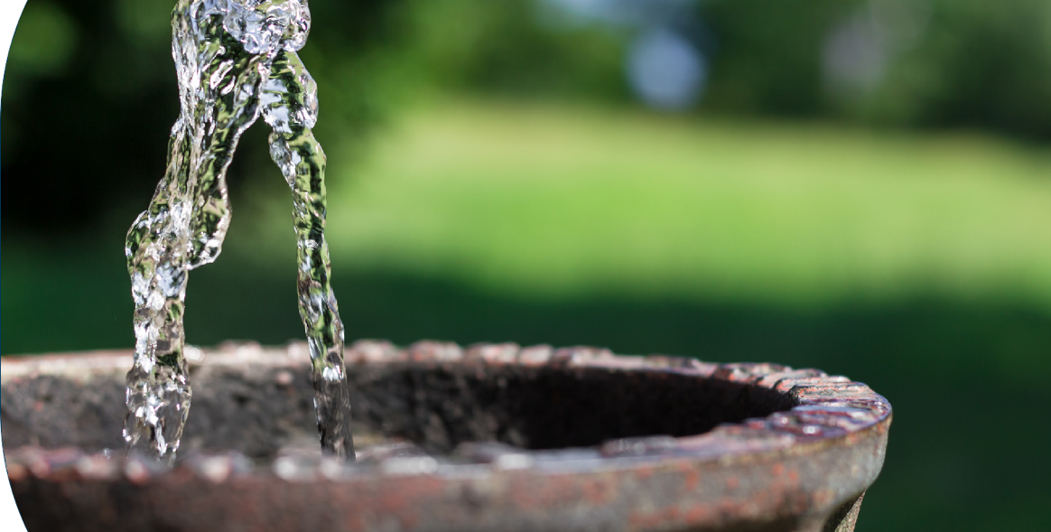
#mission water

